Slide 1


3. Graphs
basic definitions and applications
graph connectivity and graph traversal
testing bipartiteness
connectivity in directed graphs
DAGs and topological ordering
Lecture slides by Kevin Wayne Copyright © 2005 Pearson-Addison Wesley
Copyright © 2013 Kevin Wayne
http://www.cs.princeton.edu/~wayne/kleinberg-tardos
Last updated on Sep 8, 2013 6:19 AM

Slide 2


3. Graphs
basic definitions and applications
graph connectivity and graph traversal
testing bipartiteness
connectivity in directed graphs
DAGs and topological ordering
Section 3.1

Slide 3
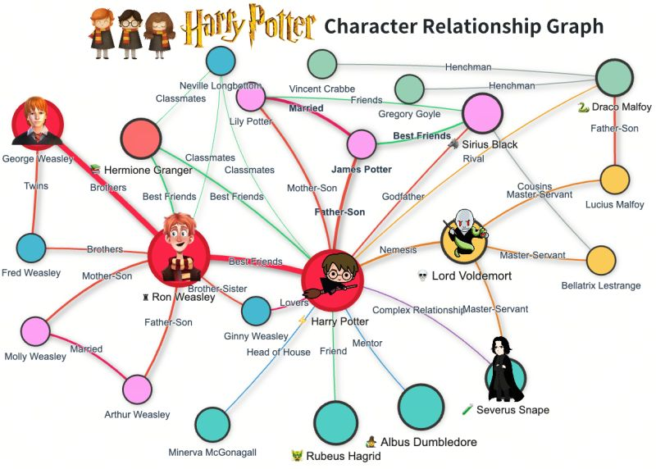
Example of Graphs

Slide 4
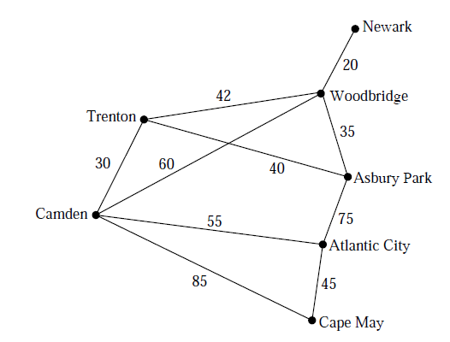
Example of Graphs

Slide 5
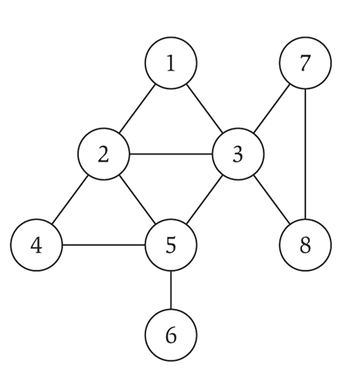
Undirected graphs
Notation. G = (V, E)
・V = nodes.
・E = edges between pairs of nodes.
・Captures pairwise relationship between objects.
・Graph size parameters: n = | V |, m = | E |.
V = { 1, 2, 3, 4, 5, 6, 7, 8 }
E = { 1-2, 1-3, 2-3, 2-4, 2-5, 3-5, 3-7, 3-8, 4-5, 5-6, 7-8 }
m = 11, n = 8

Slide 6
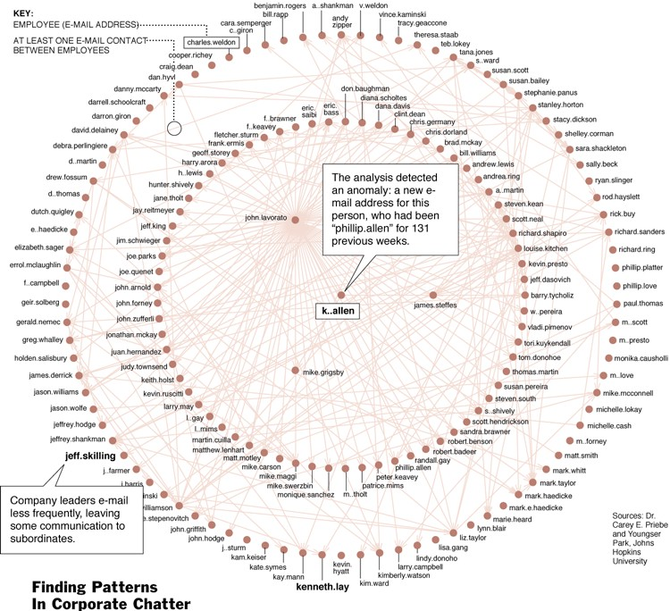
One week of Enron emails

Slide 7
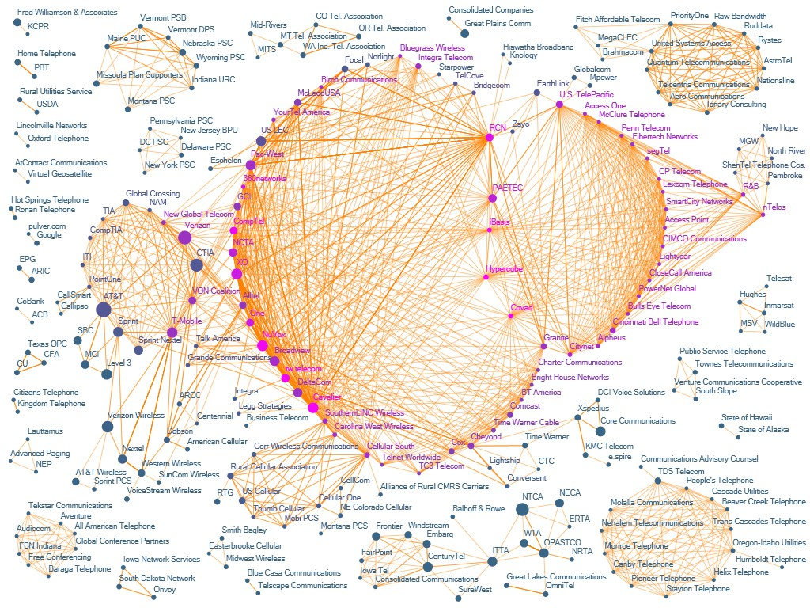
The evolution of FCC lobbying coalitions
“The Evolution of FCC Lobbying Coalitions” by Pierre de Vries in JoSS Visualization Symposium 2010

Slide 8
Some graph applications
graph | node | edge
communication | telephone, computer | fiber optic cable
circuit | gate, register, processor | wire
mechanical | joint | rod, beam, spring
financial | stock, currency | transactions
transportation | street intersection, airport | highway, airway route
internet | class C network | connection
game | board position | legal move
social relationship | person, actor | friendship, movie cast
neural network | neuron | synapse
protein network | protein | protein-protein interaction
molecule | atom | bond

Slide 9

Graph representation: adjacency matrix
Adjacency matrix. n- by -n matrix with A_{uv} = 1 if (u, v) is an edge.
・Two representations of each edge.
・Space proportional to n².
・Checking if (u, v) is an edge takes Θ(1) time.
・Identifying all edges takes Θ(n²) time.
 | 1 | 2 | 3 | 4 | 5 | 6 | 7 | 8
1 | 0 | 1 | 1 | 0 | 0 | 0 | 0 | 0
2 | 1 | 0 | 1 | 1 | 1 | 0 | 0 | 0
3 | 1 | 1 | 0 | 0 | 1 | 0 | 1 | 1
4 | 0 | 1 | 0 | 0 | 1 | 0 | 0 | 0
5 | 0 | 1 | 1 | 1 | 0 | 1 | 0 | 0
6 | 0 | 0 | 0 | 0 | 1 | 0 | 0 | 0
7 | 0 | 0 | 1 | 0 | 0 | 0 | 0 | 1
8 | 0 | 0 | 1 | 0 | 0 | 0 | 1 | 0

Slide 10

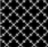
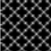
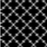
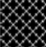
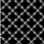
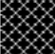
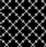
Graph representation: adjacency lists
Adjacency lists. Node indexed array of lists.
・Two representations of each edge.
・Space is Θ(m + n).
・Checking if (u, v) is an edge takes O(degree(u)) time.
・Identifying all edges takes Θ(m + n) time.
degree = number of neighbors of u
1
2
3
2
1
3
4
5
3
4
1
2
5
7
8
2
5
5
2
3
4
6
6
7
5
3
8
8
3
7

Slide 11
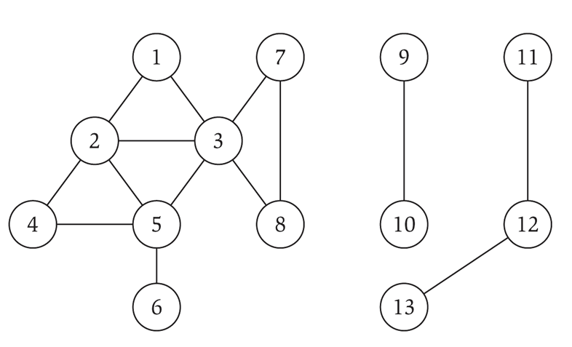
Paths and connectivity
Def. A path in an undirected graph G = (V, E) is a sequence of nodes v1, v2, …, vk with the property that each consecutive pair vi–1, vi is joined by an edge in E.
Def. A path is simple if all nodes are distinct.
Def. An undirected graph is connected if for every pair of nodes u and v, there is a path between u and v.

Slide 12
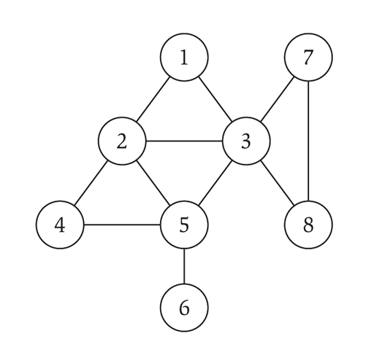
Cycles
Def. A cycle is a path v1, v2, …, vk in which v₁ = v_{k}, k > 2, and the first k – 1
nodes are all distinct.
cycle C = 1-2-4-5-3-1

Slide 13
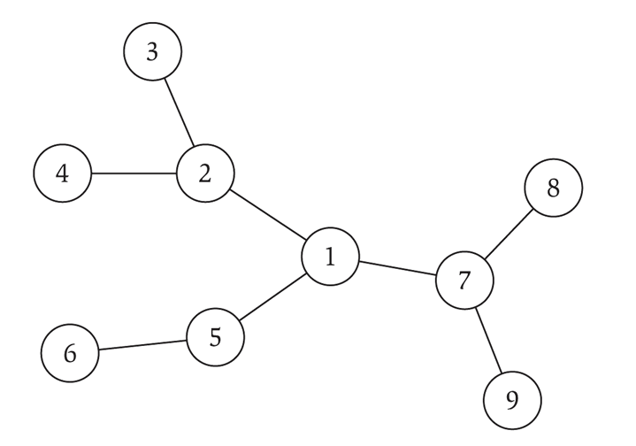
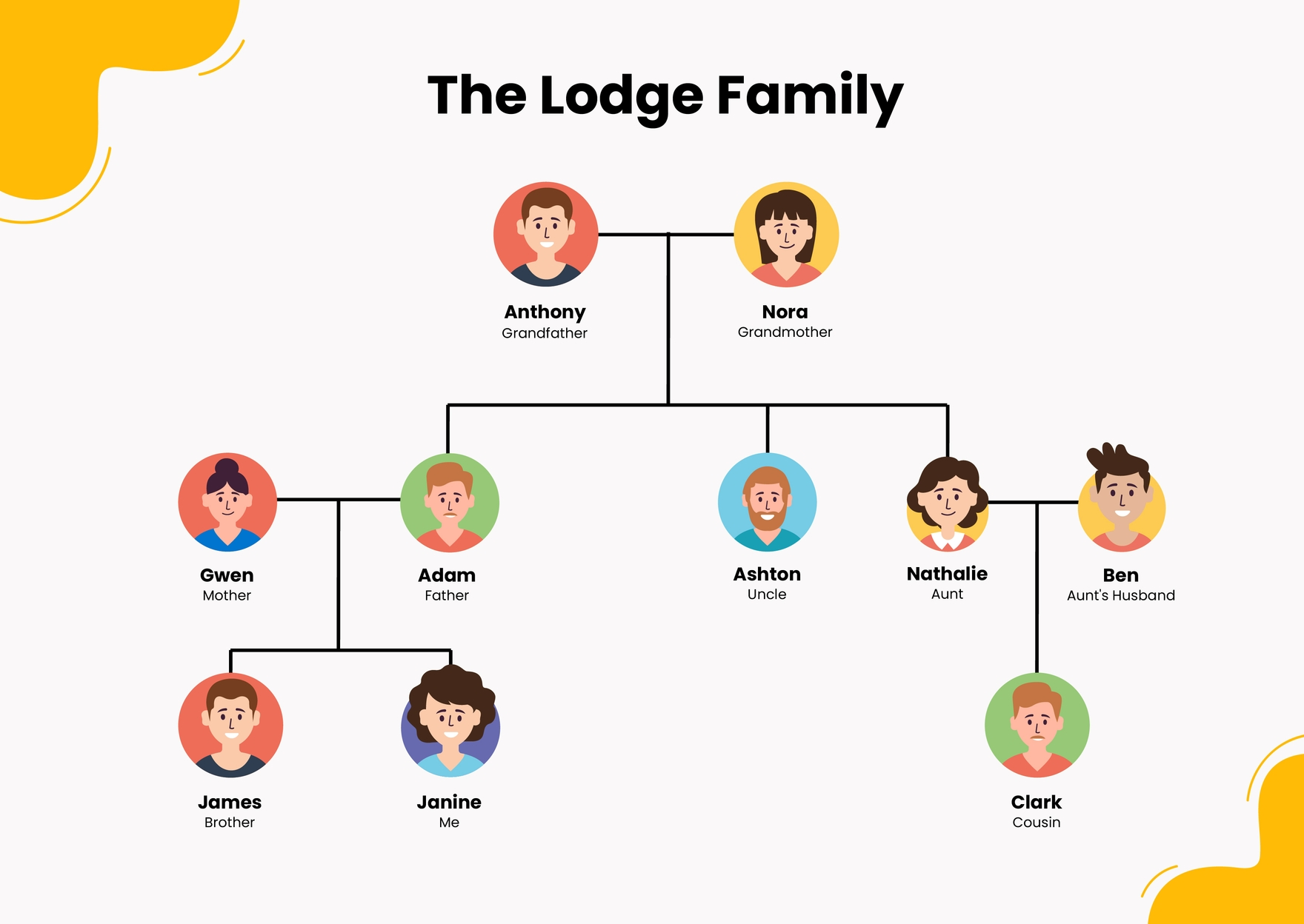
Trees
Def. An undirected graph is a tree if it is connected and does not contain a cycle.
Theorem. Let G be an undirected graph on n nodes. Any two of the following statements imply the third.
・G is connected.
・G does not contain a cycle.
・G has n – 1 edges.

Slide 14
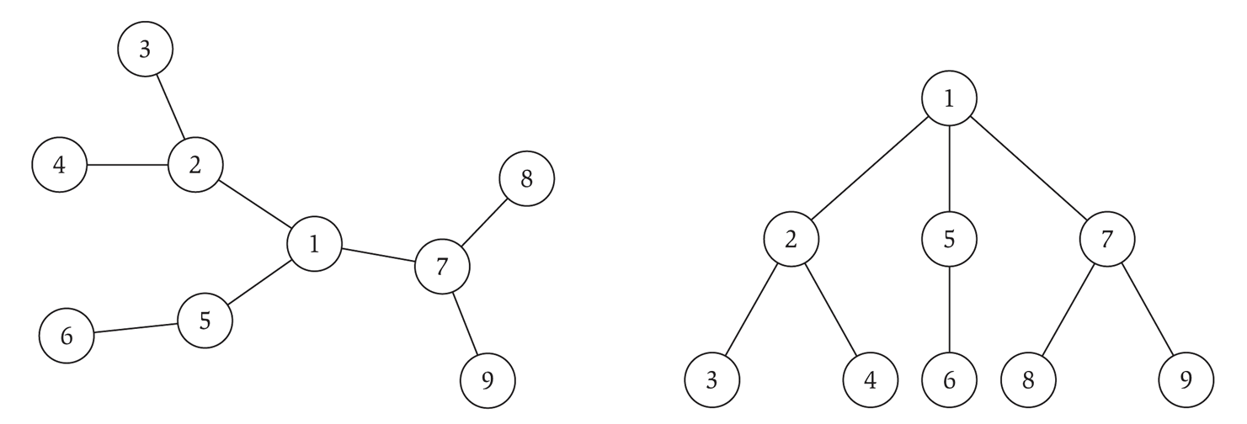
Rooted trees
Given a tree T, choose a root node r and orient each edge away from r.
Importance. Models hierarchical structure.
root r
parent of v
v
child of v
a tree
the same tree, rooted at 1

Slide 15
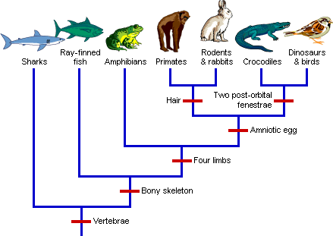
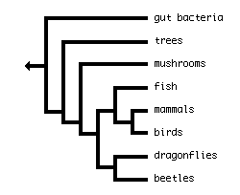
Phylogeny trees
Describe evolutionary history of species.

Slide 16
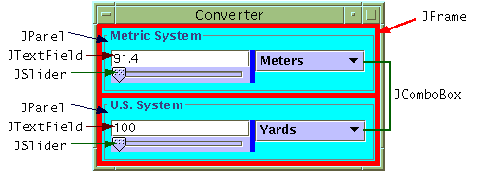
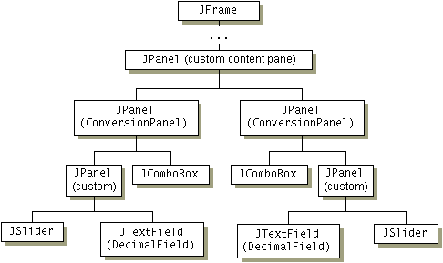
GUI containment hierarchy
Describe organization of GUI widgets.
http://java.sun.com/docs/books/tutorial/uiswing/overview/anatomy.html

Slide 17
3. Graphs
basic definitions and applications
graph connectivity and graph traversal
testing bipartiteness
connectivity in directed graphs
DAGs and topological ordering
Section 3.2

Slide 18
Connectivity
s-t connectivity problem. Given two node s and t, is there a path between s
and t ?
s-t shortest path problem. Given two node s and t, what is the length of the shortest path between s and t ?
Applications.
・navigation map.
・Maze traversal.
・Fewest number of hops in a communication network.

Slide 19
Breadth-first search
BFS intuition. Explore outward from s in all possible directions, adding nodes one "layer" at a time.
BFS algorithm.
s
L₁
L₂
^{L}n–1
・L₀ = { s }.
・L₁ = all neighbors of L₀.
・L₂ = all nodes that do not belong to L₀ or L₁, and that have an edge to a
・L_{i+1} = all nodes that do not belong to an earlier layer, and that have an edge to a node in L_{i}.
node in L₁.
Theorem. For each i, L_{i} consists of all nodes at distance exactly i
from s. There is a path from s to t iff t appears in some layer.

Slide 20
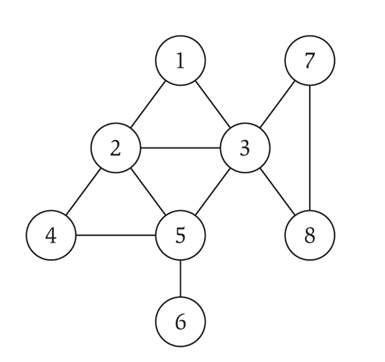
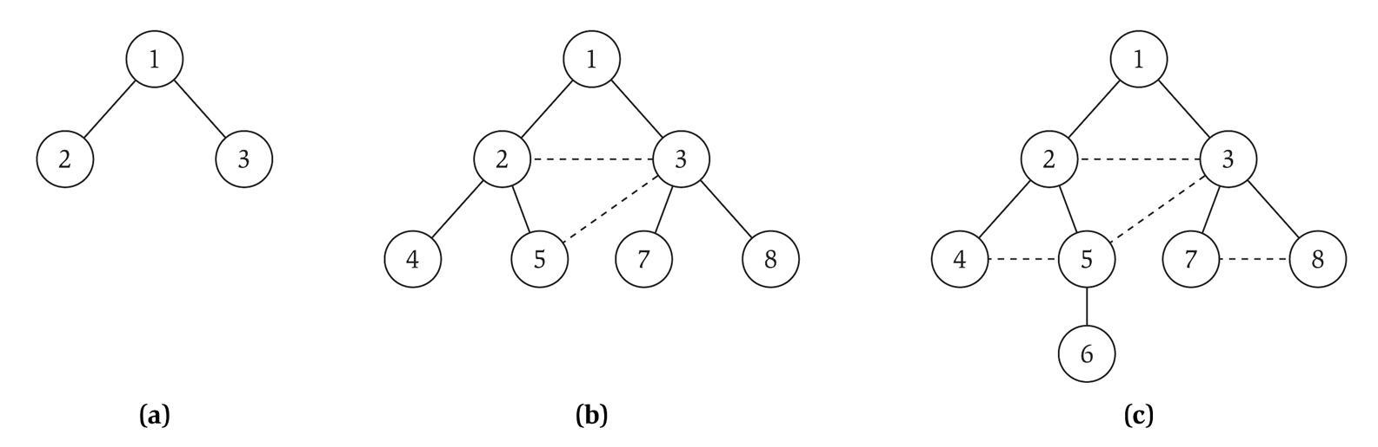
Breadth-first search
Property. Let T be a BFS tree of G = (V, E), and let (x, y) be an edge of G. Then, the level of x and y differ by at most 1.
L₀
L₁
L₂
L₃

Slide 21
Breadth-first search: analysis
Theorem. The above implementation of BFS runs in O(m + n) time if the graph is given by its adjacency representation.
Pf.
・Easy to prove O(n²) running time:
at most n lists L[i]
each node occurs on at most one list; for loop runs ≤ n times
when we consider node u, there are ≤ n incident edges (u, v), and we spend O(1) processing each edge
・Actually runs in O(m + n) time:
when we consider node u, there are degree(u) incident edges (u, v)
total time processing edges is Σ_{u∈V} degree(u) = 2m. ▪
each edge (u, v) is counted exactly twice
in sum: once in degree(u) and once in degree(v)

Slide 22
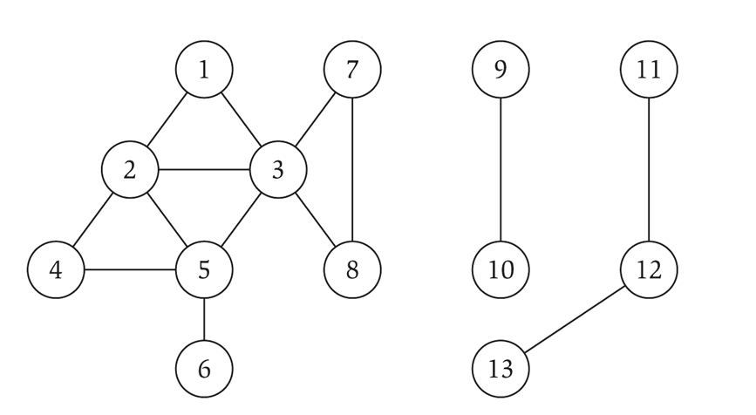
Connected component
Connected component. Find all nodes reachable from s.
Connected component containing node 1 = { 1, 2, 3, 4, 5, 6, 7, 8 }.

Slide 23

Flood fill
Flood fill. Given lime green pixel in an image, change color of entire blob of neighboring lime pixels to blue.
・Node: pixel.
・Edge: two neighboring lime pixels.
・Blob: connected component of lime pixels.
recolor lime green blob to blue

Slide 24

Flood fill
Flood fill. Given lime green pixel in an image, change color of entire blob of neighboring lime pixels to blue.
・Node: pixel.
・Edge: two neighboring lime pixels.
・Blob: connected component of lime pixels.
recolor lime green blob to blue

Slide 25
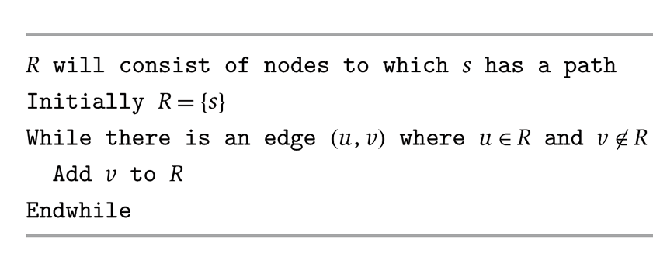
Connected component
Connected component. Find all nodes reachable from s.
R
s
u
v
it's safe to add v
Theorem. Upon termination, R is the connected component containing s.
・BFS = explore in order of distance from s.
・DFS = explore in a different way.

Slide 26
3. Graphs
basic definitions and applications
graph connectivity and graph traversal
testing bipartiteness
connectivity in directed graphs
DAGs and topological ordering
Section 3.4

Slide 27
Bipartite graphs
Def. An undirected graph G = (V, E) is bipartite if the nodes can be colored blue or white such that every edge has one white and one blue end.
Applications.
・Stable marriage: men = blue, women = white.
・Scheduling: machines = blue, jobs = white.
a bipartite graph

Slide 28
Testing bipartiteness
Many graph problems become:
・Easier if the underlying graph is bipartite (matching).
・Tractable if the underlying graph is bipartite (independent set).
Before attempting to design an algorithm, we need to understand structure of bipartite graphs.
v₂
v₂
v₃
v₄
v₆
v₅
v₄
v₅
v₇
v₁
v₇
a bipartite graph G
another drawing of G

Slide 29
An obstruction to bipartiteness
Lemma. If a graph G is bipartite, it cannot contain an odd length cycle.
Pf. Not possible to 2-color the odd cycle, let alone G.
bipartite (2-colorable)
not bipartite (not 2-colorable)

Slide 30
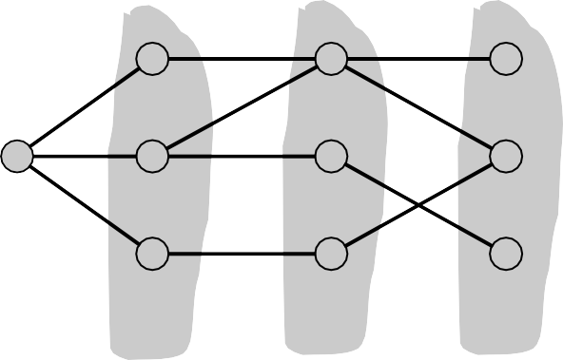
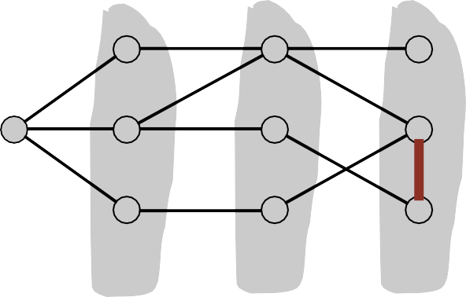
Bipartite graphs
Lemma. Let G be a connected graph, and let L₀, …, L_{k} be the layers produced by BFS starting at node s. Exactly one of the following holds.
No edge of G joins two nodes of the same layer, and G is bipartite.
An edge of G joins two nodes of the same layer, and G contains an odd-length cycle (and hence is not bipartite).
L₁
L₂
L₃
L₁
L₂
L₃
Case (i)
Case (ii)

Slide 31
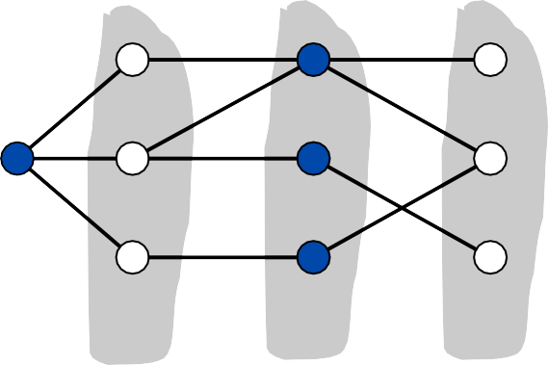
Bipartite graphs
Lemma. Let G be a connected graph, and let L₀, …, L_{k} be the layers produced by BFS starting at node s. Exactly one of the following holds.
No edge of G joins two nodes of the same layer, and G is bipartite.
An edge of G joins two nodes of the same layer, and G contains an odd-length cycle (and hence is not bipartite).
Pf. (i)
・Suppose no edge joins two nodes in adjacent layers.
・By previous lemma, this implies all edges join nodes on same level.
・Bipartition: red = nodes on odd levels, blue = nodes on even levels.
L₁
L₂
L₃
Case (i)

Slide 32
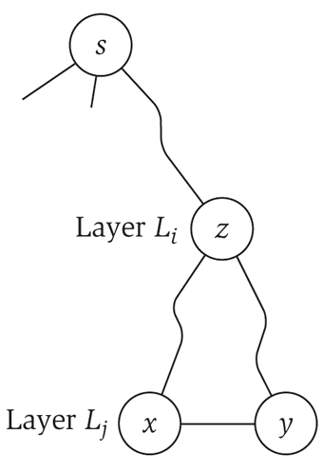
Bipartite graphs
Lemma. Let G be a connected graph, and let L₀, …, L_{k} be the layers produced by BFS starting at node s. Exactly one of the following holds.
No edge of G joins two nodes of the same layer, and G is bipartite.
An edge of G joins two nodes of the same layer, and G contains an odd-length cycle (and hence is not bipartite).
Pf. (ii)
・Suppose (x, y) is an edge with x, y in same level L_{j}.
・Let z = lca(x, y) = lowest common ancestor.
z = lca(x, y)
・Let L_{i} be level containing z.
・Consider cycle that takes edge from x to y, then path from y to z, then path from z to x.
・Its length is 1 + (j – i) + (j – i), which is odd. ▪
(x, y)
path from y to z
path from z to x

Slide 33
The only obstruction to bipartiteness
Corollary. A graph G is bipartite iff it contain no odd length cycle.
5-cycle C
bipartite (2-colorable)
not bipartite (not 2-colorable)

Slide 34
3. Graphs
basic definitions and applications
graph connectivity and graph traversal
testing bipartiteness
connectivity in directed graphs
DAGs and topological ordering
Section 3.5

Slide 35
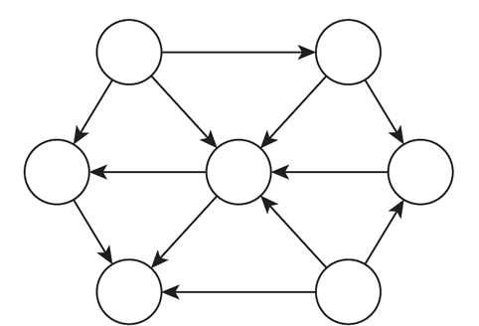
Directed graphs
Notation. G = (V, E).
・Edge (u, v) leaves node u and enters node v.
Ex. Web graph: hyperlink points from one web page to another.
・Orientation of edges is crucial.
・Modern web search engines exploit hyperlink structure to rank web pages by importance.

Slide 36
World wide web
Web graph.
・Node: web page.
・Edge: hyperlink from one page to another (orientation is crucial).
・Modern search engines exploit hyperlink structure to rank web pages by importance.
cnn.com
netscape.com
novell.com
cnnsi.com
timewarner.com
hbo.com
sorpranos.com

Slide 37
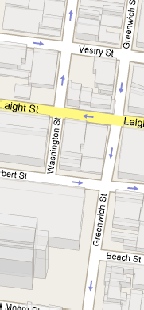
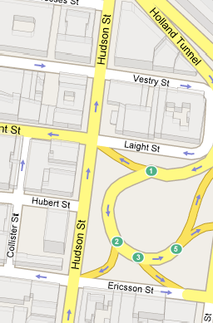
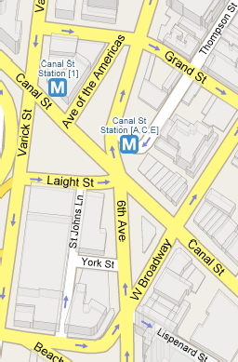
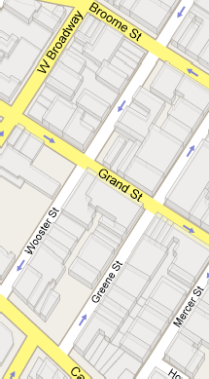
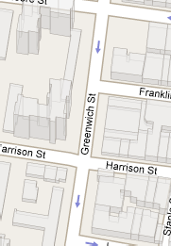
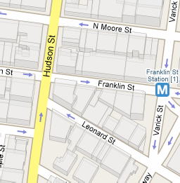
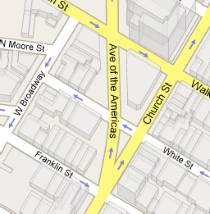
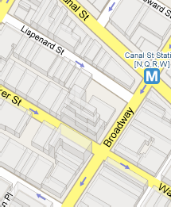
Road network
Vertex = intersection; edge = one-way street.
©2008 Google - Map data ©2008 Sanborn, NAVTEQ™ - Terms of Use

Slide 38
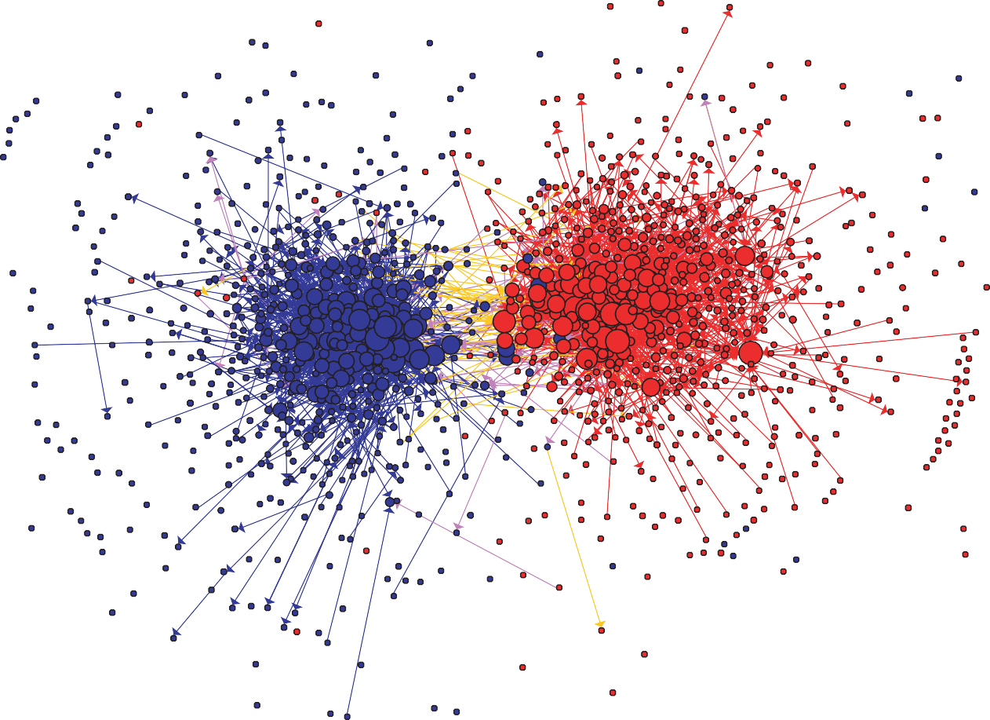
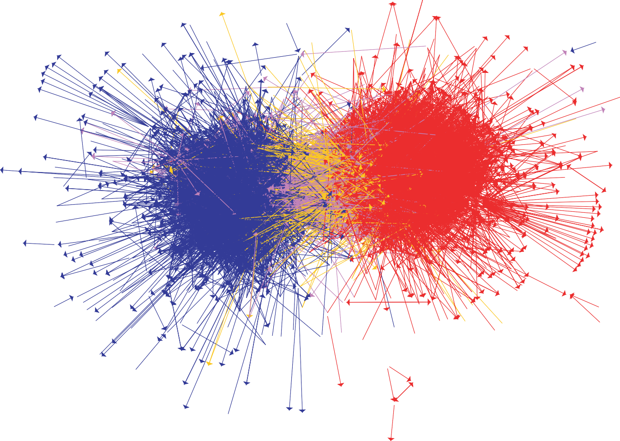
Political blogosphere graph
Vertex = political blog; edge = link.
The Political Blogosphere and the 2004 U.S. Election: Divided They Blog, Adamic and Glance, 2005

Slide 39
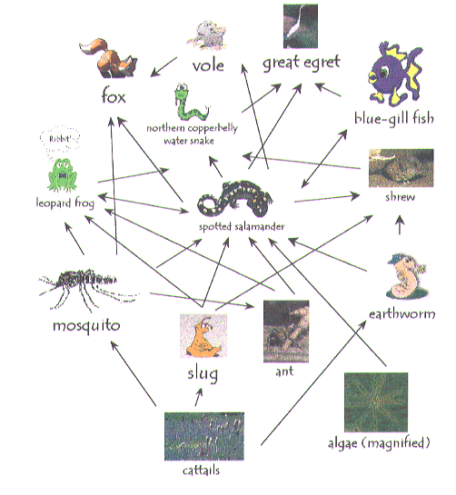
Ecological food web
Food web graph.
・Node = species.
・Edge = from prey to predator.
Reference: http://www.twingroves.district96.k12.il.us/Wetlands/Salamander/SalGraphics/salfoodweb.giff

Slide 40
Some directed graph applications
directed graph | node | directed edge
transportation | street intersection | one-way street
web | web page | hyperlink
food web | species | predator-prey relationship
WordNet | synset | hypernym
scheduling | task | precedence constraint
financial | bank | transaction
cell phone | person | placed call
infectious disease | person | infection
game | board position | legal move
citation | journal article | citation
object graph | object | pointer
inheritance hierarchy | class | inherits from
control flow | code block | jump

Slide 41
Graph search
Directed reachability. Given a node s, find all nodes reachable from s.
Directed s-t shortest path problem. Given two node s and t, what is the length of the shortest path from s and t ?
Graph search. BFS extends naturally to directed graphs.
Web crawler. Start from web page s. Find all web pages linked from s, either directly or indirectly.

Slide 42



Strong connectivity
Def. Nodes u and v are mutually reachable if there is a both path from u to v
and also a path from v to u.
Def. A graph is strongly connected if every pair of nodes is mutually reachable.
Lemma. Let s be any node. G is strongly connected iff every node is reachable from s, and s is reachable from every node.
Pf. | ⇒ Follows from definition.
Pf. | ⇐ Path from u to v: concatenate u↝s path with s↝v path.
 | Path from v to u: concatenate v↝s path with s↝u path. | ▪
ok if paths overlap
s
u
v

Slide 43

Strong connectivity: algorithm
Theorem. Can determine if G is strongly connected in O(m + n) time. Pf.
・Pick any node s.
・Run BFS from s in G.
reverse orientation of every edge in G
・Run BFS from s in G^{reverse}.
・Return true iff all nodes reached in both BFS executions.
・Correctness follows immediately from previous lemma. ▪
strongly connected
not strongly connected

Slide 44
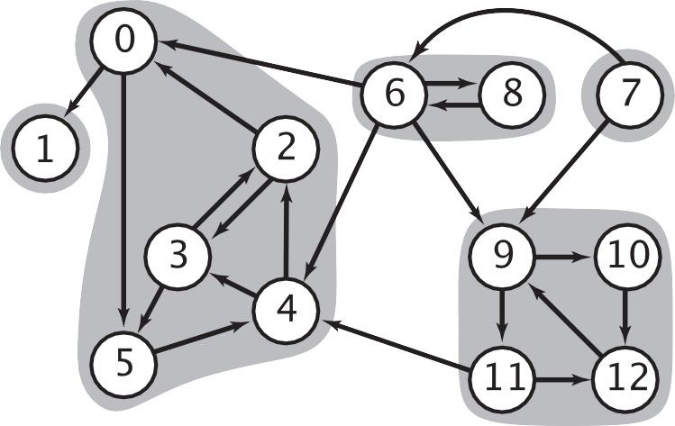
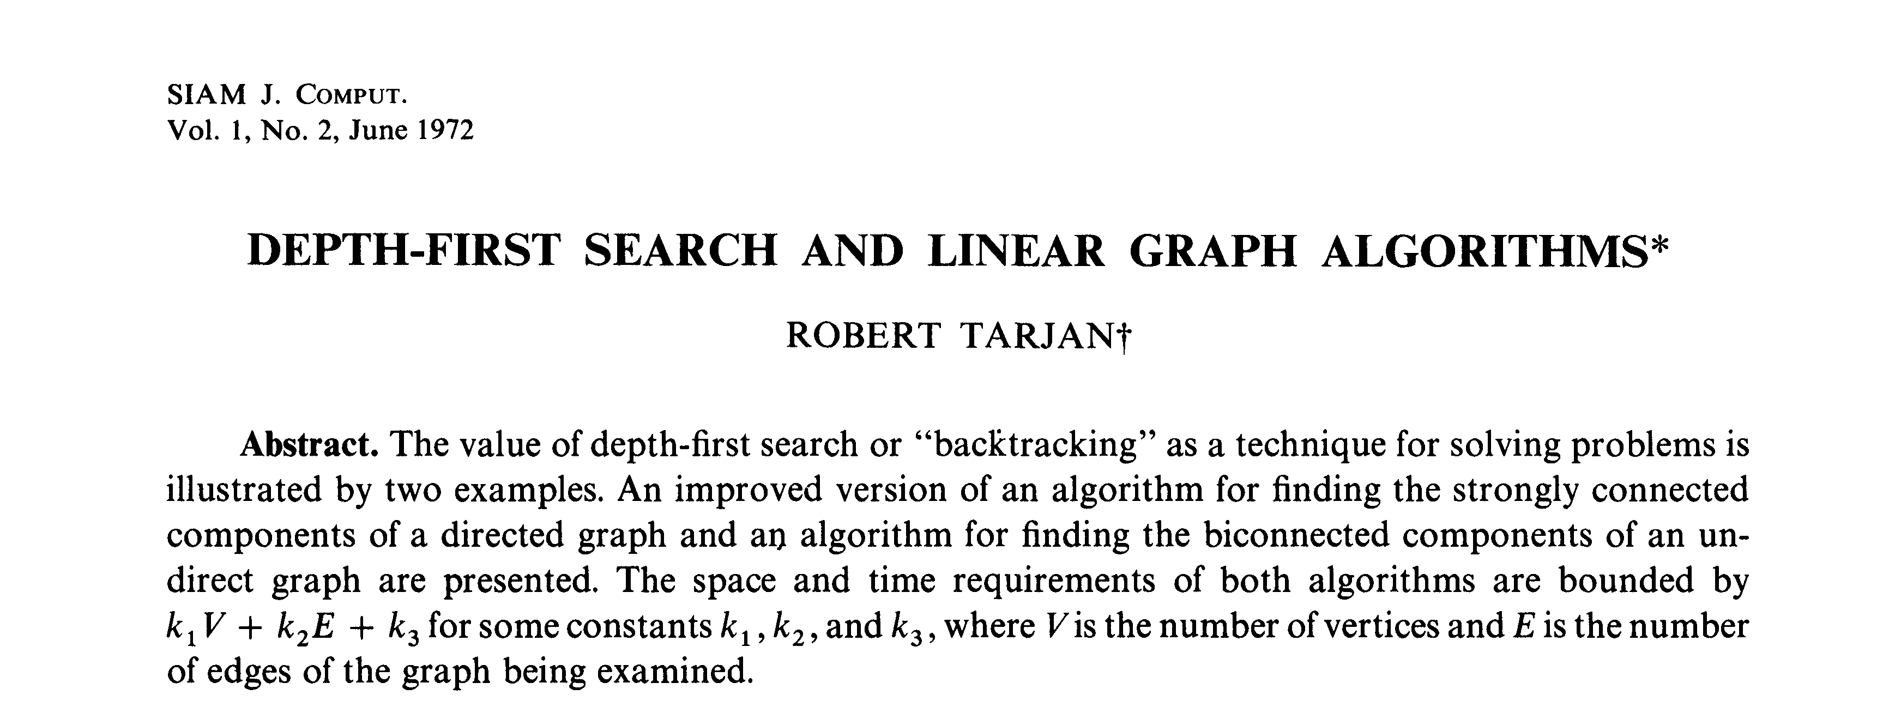
Strong components
Def. A strong component is a maximal subset of mutually reachable nodes.
Theorem. [Tarjan 1972] Can find all strong components in O(m + n) time.

Slide 45
3. Graphs
basic definitions and applications
graph connectivity and graph traversal
testing bipartiteness
connectivity in directed graphs
DAGs and topological ordering
Section 3.6

Slide 46
Directed acyclic graphs
Def. A DAG is a directed graph that contains no directed cycles.
Def. A topological order of a directed graph G = (V, E) is an ordering of its nodes as v₁, v₂, …, v_{n} so that for every edge (v_{i}, v_{j}) we have i < j.
v₂
v₃
v₆
v₅
v₄
v₁
v₂
v₃
v₄
v₅
v₆
v₇
v₇
v₁
a DAG
a topological ordering

Slide 47
Precedence constraints
Precedence constraints. Edge (v_{i}, v_{j}) means task v_{i} must occur before v_{j}.
Applications.
・Course prerequisite graph: course v_{i} must be taken before v_{j}.
・Compilation: module v_{i} must be compiled before v_{j}. Pipeline of computing jobs: output of job v_{i} needed to determine input of job v_{j}.

Slide 48
Directed acyclic graphs
Lemma. If G has a topological order, then G is a DAG.
Pf. [by contradiction]
・Suppose that G has a topological order v₁, v₂, …, v_{n} and that G also has a directed cycle C. Let's see what happens.
・Let v_{i} be the lowest-indexed node in C, and let v_{j} be the node just before v_{i}; thus (v_{j}, v_{i}) is an edge.
・By our choice of i, we have i < j.
・On the other hand, since (v_{j}, v_{i}) is an edge and v₁, v₂, …, v_{n} is a topological order, we must have j < i, a contradiction. ▪
the directed cycle C
v₁
v_{i}
v_{j}
v_{n}
the supposed topological order: v₁, …, v_{n}

Slide 49
Directed acyclic graphs
Lemma. If G has a topological order, then G is a DAG.
Q. Does every DAG have a topological ordering?
Q. If so, how do we compute one?

Slide 50
Directed acyclic graphs
Lemma. If G is a DAG, then G has a node with no entering edges.
Pf. [by contradiction]
・Suppose that G is a DAG and every node has at least one entering edge.
・Pick any node v, and begin following edges backward from v. Since v
has at least one entering edge (u, v) we can walk backward to u.
Let's see what happens.
・Then, since u has at least one entering edge (x, u), we can walk backward to x.
・Repeat until we visit a node, say w, twice.
・Let C denote the sequence of nodes encountered between successive visits to w. C is a cycle. ▪
w
x
u
v

Slide 51

Proof By Induction

Slide 52
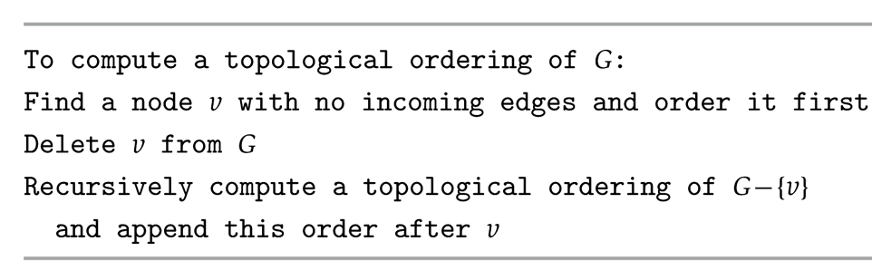
Directed acyclic graphs
Lemma. If G is a DAG, then G has a topological ordering.
Pf. [by induction on n]
・Base case: true if n = 1.
・Given DAG on n > 1 nodes, find a node v with no entering edges.
・G – { v } is a DAG, since deleting v cannot create cycles.
・By inductive hypothesis, G – { v } has a topological ordering.
・Place v first in topological ordering; then append nodes of G – { v }
・in topological order. This is valid since v has no entering edges. ▪
DAG
v

Slide 53
Topological sorting algorithm: running time
Theorem. Algorithm finds a topological order in O(m + n) time. Pf.
・Maintain the following information:
count(w) = remaining number of incoming edges
S = set of remaining nodes with no incoming edges
・Initialization: O(m + n) via single scan through graph.
・Update: to delete v
remove v from S
decrement count(w) for all edges from v to w; and add w to S if count(w) hits 0
this is O(1) per edge ▪

Slide 54

网络视频
https://www.youtube.com/watch?v=LFKZLXVO-Dg
温馨提示：此视频框在点击“上传手机课件”时会进行转换，用手机进行观看时则会变为可点击的视频。此视频框可被拖动移位和修改大小。

